Slide 1
DIVIDE AND CONQUER

Slide 2
INTRODUCTION
Divide-and-conquer refers to a class of algorithmic techniques in which one breaks the input into several parts, solves the problem in each part recursively, and then combines the solutions to these sub-problems into an overall solution.

Slide 3
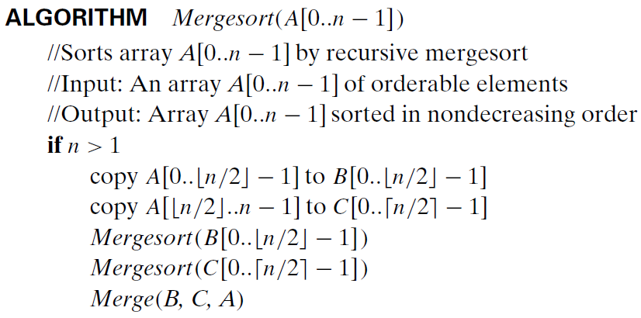
MERGE SORT

Slide 4
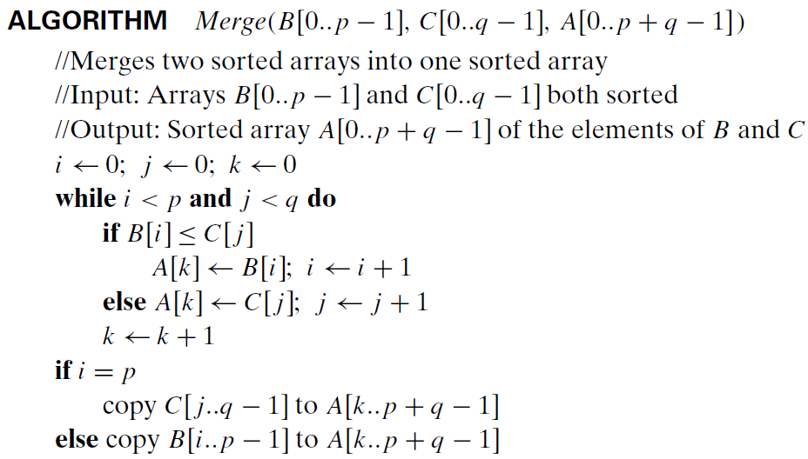
MERGE SORT

Slide 5

MERGE SORT

Slide 6
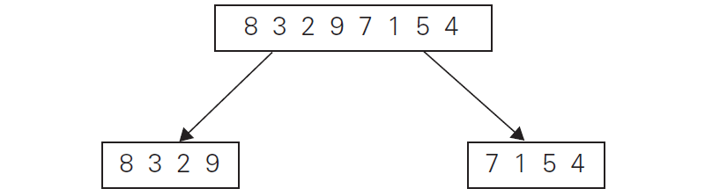
MERGE SORT

Slide 7
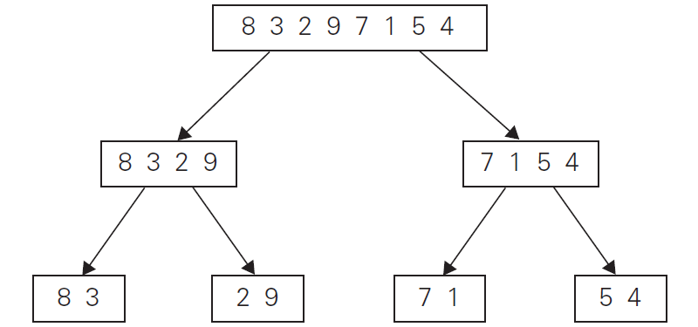
MERGE SORT

Slide 8
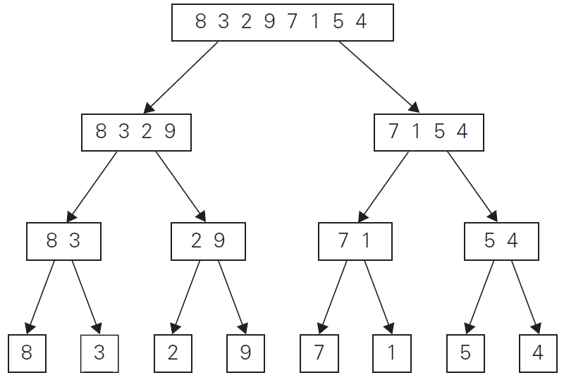
MERGE SORT

Slide 9
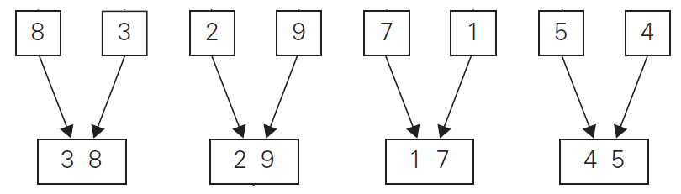
MERGE SORT

Slide 10
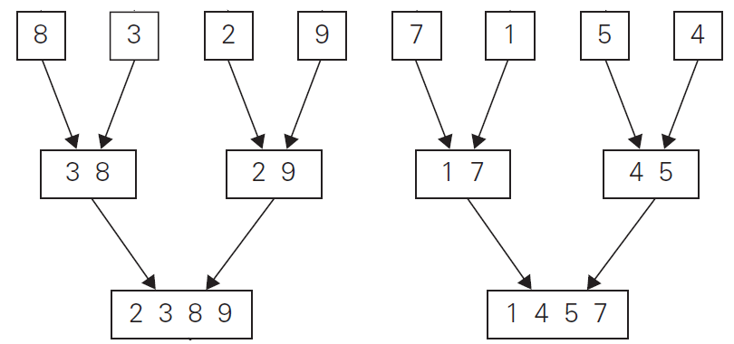
MERGE SORT

Slide 11
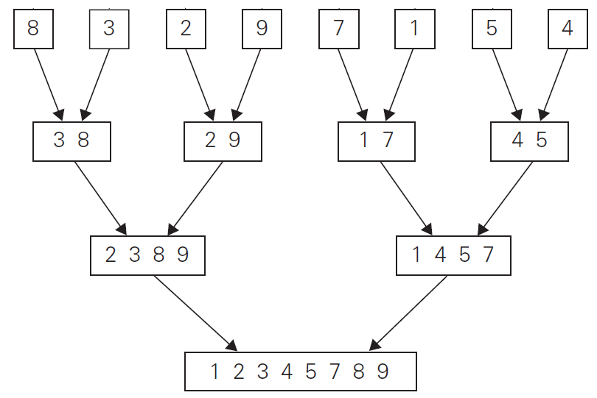
MERGE SORT

Slide 12
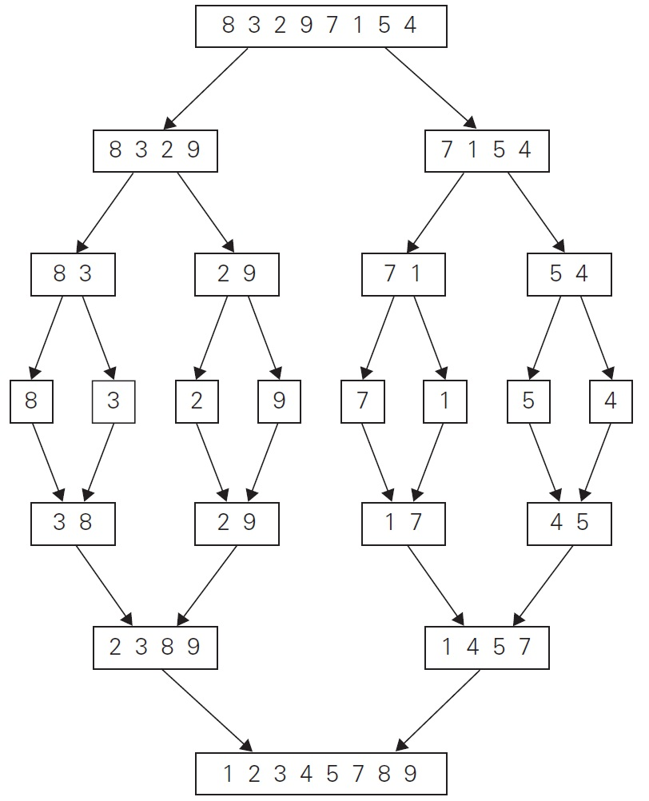
MERGE SORT

Slide 13
MERGE SORT
Sort the following list using Merge sort
E | X | A | M | P | L | E

Slide 14
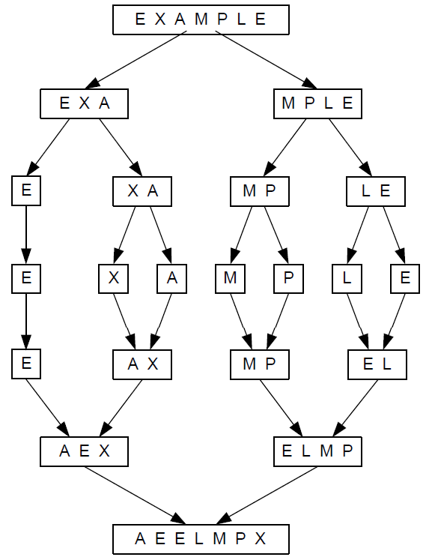
MERGE SORT

Slide 15
MERGESORT ANALYSIS

Slide 16
APPROACHES TO SOLVE RECURSION
Approach 1:
Intuitive solution to recurrence is to “unroll” the recursion, accounting for the running time of first few levels.
Identify a pattern that can be continued as the recursion expands.
Sum the running times over all levels of the recursion and thereby arrives at a total running time.

Slide 17
Step1: Analyze the first few levels.
1st level of recursion → Single problem of size n → O(n)
2nd level of recursion → 2 problems each of size n/2 → O(n/2)
3rd level of recursion → 4 problems each of size n/4 → O(n/4)
Step 2: Identifying the pattern.
At level j of the recursion, the number of subproblems are now a total of 2^{j}
Each problem has shrunk in size by factor of 2 “j” time → n/ 2^{j}
Step 3: Summing overall levels of recursion.
The number of times the input must be halved to reduce the size of n to 2 is log n
There are totally “n” levels of recursion → O( n logn)

Slide 18
T(n)
n
T(n/2)
T(n/2)
2(n/2)
T(n/4)
T(n/4)
T(n/4)
T(n/4)
4(n/4)
log₂n
. . .
T(n / 2^{k})
2^{k} (n / 2^{k})
. . .
T(2)
T(2)
T(2)
T(2)
T(2)
T(2)
T(2)
T(2)
n/2 (2)
n log₂n

Slide 19
SUBSTITUTING A SOLUTION INTO THE MERGESORT RECURSION
T(n) = 2T(n/2) + n ..........(1)
T(n/2) = 2T(n/4) + n/2 ........(2)
Put (2) in (1)
T(n) = 2 { 2T(n/4) + n/2 } + n
= 2²T(n/4) + n + n
= 2³T(n/8) + n + n + n
= 2⁴T(n/16) + n + n + n + n
= 2^{k}T(n/2^{k}) + n + n + n + n + n.....(k times n will be present)
= 2^{k}T(n/2^{k}) + nk
Now put 2^{k} = n, so k will be log₂n
So, T(n) = nT(2^{k}/2^{k}) + nlog₂n
= nT(1) + nlog₂n
= n + nlog₂n
Hence, T(n) = O( nlog₂n )

Slide 20
COUNTING INVERSION

Slide 21
COUNTING INVERSION
Introduction
We are given a sequence of n numbers a1, . . . , an.
We will assume that all the numbers are distinct.
We want to define a measure that tells us how far this list is from being in ascending order.
The value of the measure should be 0 if a1< a2 < . . .< an, and should increase as the numbers become more scrambled.

Slide 22
COUNTING INVERSION
Counting the Number of Inversions
The two indices i < j form an inversion if ai > aj, that is, if the two elements ai and aj are “out of order.”
Counting the number of inversions is to determine the number of inversions in the sequence a1, . . . , an.

Slide 23
COUNTING INVERSION
Example
Sequence is 2, 4, 1, 3, 5.
There are three inversions in this sequence: (2, 1), (4, 1), and (4, 3).

Slide 24
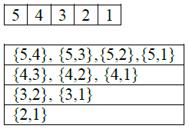
COUNTING INVERSION
Example
If the sequence is in descending order, then every pair forms an inversion, and so there are n(n-1)/2 pairs.

Slide 25
COUNTING INVERSION
Algorithm
Look at every pair of numbers (ai , aj) and determine whether they constitute an inversion.
This would take O(n^2) time.
The basic idea is to follow the strategy of divide and conquer.
We set m = _n/2_ and divide the list into the two pieces a1, . . . , am and am+1, . . . , an.
We first count the number of inversions in each of these two halves separately.
Then we count the number of inversions (ai , aj), where the two numbers belong to different halves.

Slide 26
COUNTING INVERSION
Algorithm
Note that these first-half/second-half inversions have a particularly nice form: they are precisely the pairs (ai , aj), where ai is in the first half, aj is in the second half.
Suppose we have recursively sorted the first and second halves of the list and counted the inversions in each.
We now have two sorted lists A and B, containing the first and second halves, respectively.
We want to produce a single sorted list C from their union, while also counting the number of pairs (a, b) with a ∈ A, b ∈ B, and a > b.

Slide 27
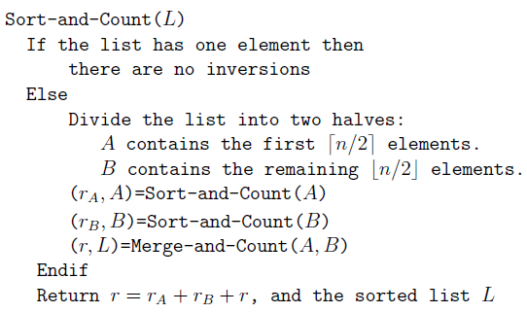
COUNTING INVERSION
Algorithm: Counting Inversions
//Purpose: To count the inversions for a given list L(a1,a2,……….an)
//Input: An unsorted list of distinct numbers L(a1,a2,……….an)
//Output: The number of inversions r for the list L(a1,a2,……….an)

Slide 28
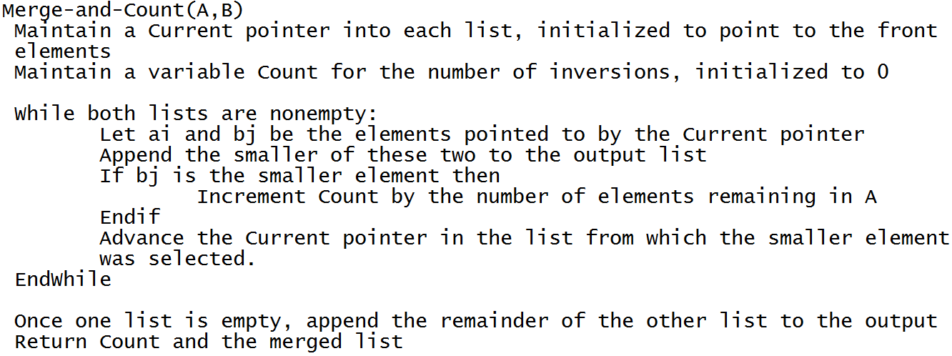
COUNTING INVERSION

Slide 29
COUNTING INVERSION
EXAMPLE
Total Inversions: 10
5 | 4 | 2 | 1 | 7 | 10 | 3 | 11 | 14 | 15

Slide 30
COUNTING INVERSION
5 | 4 | 2 | 1 | 7 | 10 | 3 | 11 | 14 | 15
5 | 4 | 2 | 1 | 7 |  |  |  | 10 | 3 | 11 | 14 | 15
5 | 4 |  | 2 | 1 | 7 |  |  | 10 | 3 |  | 11 | 14 | 15
5 |  | 4 |  | 2 |  | 1 | 7 |  | 10 |  | 3 |  | 11 |  | 14 | 15
1 |  | 7 |  |  |  |  |  | 14 |  | 15

Slide 31
COUNTING INVERSION
1 |  | 7 |  |  |  |  |  | 14 |  | 15
5 |  | 4 |  | 2 |  | 1 | 7 |  | 10 |  | 3 |  | 11 |  | 14 | 15
4 | 5 |  | 1 | 2 | 7 |  |  | 3 | 10 |  | 11 | 14 | 15
1 | 2 | 4 | 5 | 7 |  |  |  | 3 | 10 | 11 | 14 | 15
1 | 2 | 3 | 4 | 5 | 7 | 10 | 11 | 14 | 15

Slide 32
THANK YOU

